Slide 1


Titolo presentazione sottotitolo
Degree course:
Computer Science and Engineering
Milano, XX mese 20XX
Project of Complessità nei sistemi e nelle reti
Balestrieri Niccolò Milan, 7 March 2023

Slide 2

Context and objective of the project activity
Analysis of a directed graph in the field of 2004 USA politcs elections, using the tools provided during the course
Considerations on the results obtained

Slide 3
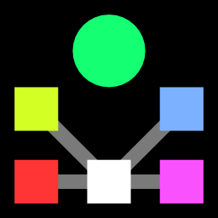
Dataset
Two different datasets were used, provided by the konect website:
Directed graph in csv format, representing a directed network contains front-page hyperlinks between blogs in the context of the 2004 US election.
CSV file containing the list of all nodes and their political orientation
To carry out the analysis on the network, various operations were carried out on the two datasets

Slide 4
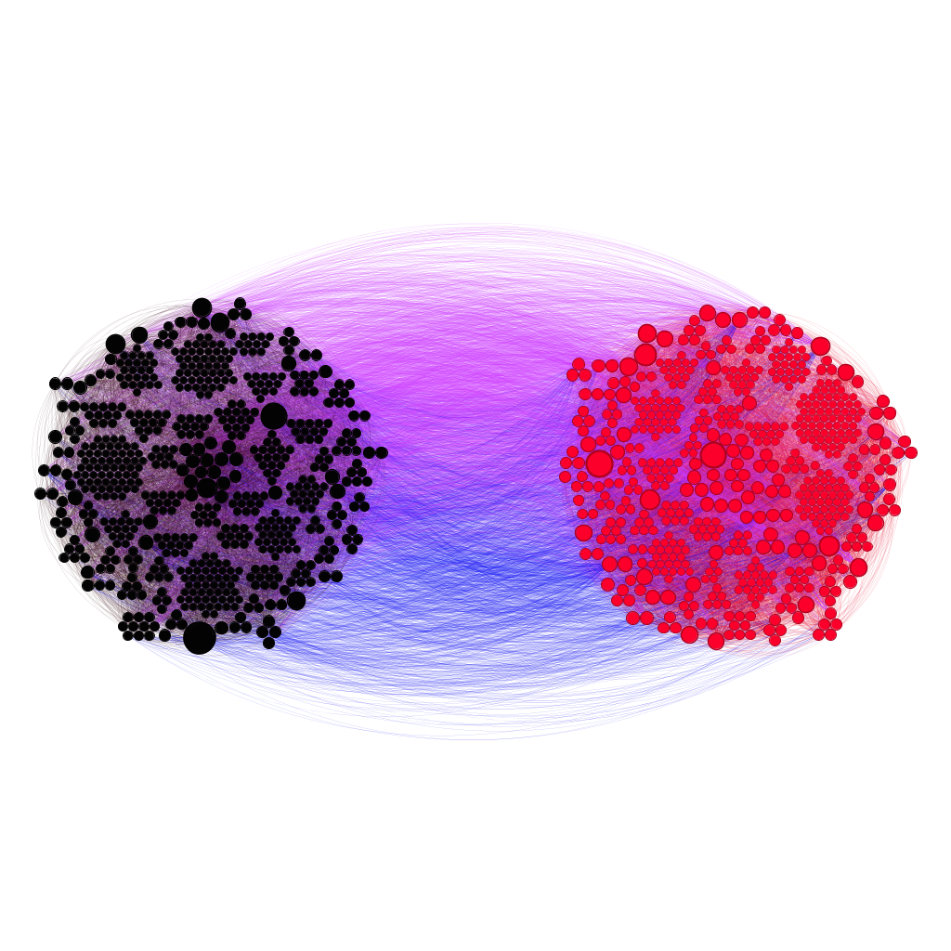
Dataset
Comparing myself with the analyzes and results obtained from the following paper:
“Lada A. Adamic and Natalie Glance. The political blogosphere and the 2004 US election: Divided they blog. In Proc. Int. Workshop on Link Discov., pages 36–43, 2005.”
I thought it appropriate to represent the following graph, which with another layout, is represented in the paper
Red nodes are the liberal blogs while the purple nodes are the conservative blogs
Blue edges are hyperlinks between conservative, while purple edges are hyperlink between conservative

Slide 5
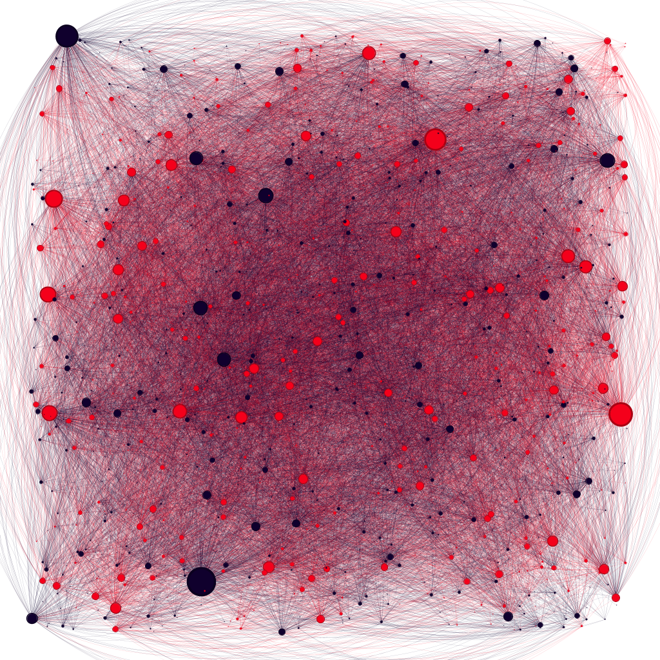
Network properties
This network has:
1224 nodes
19025 egdes
This is a directed and unweighted network

Slide 6
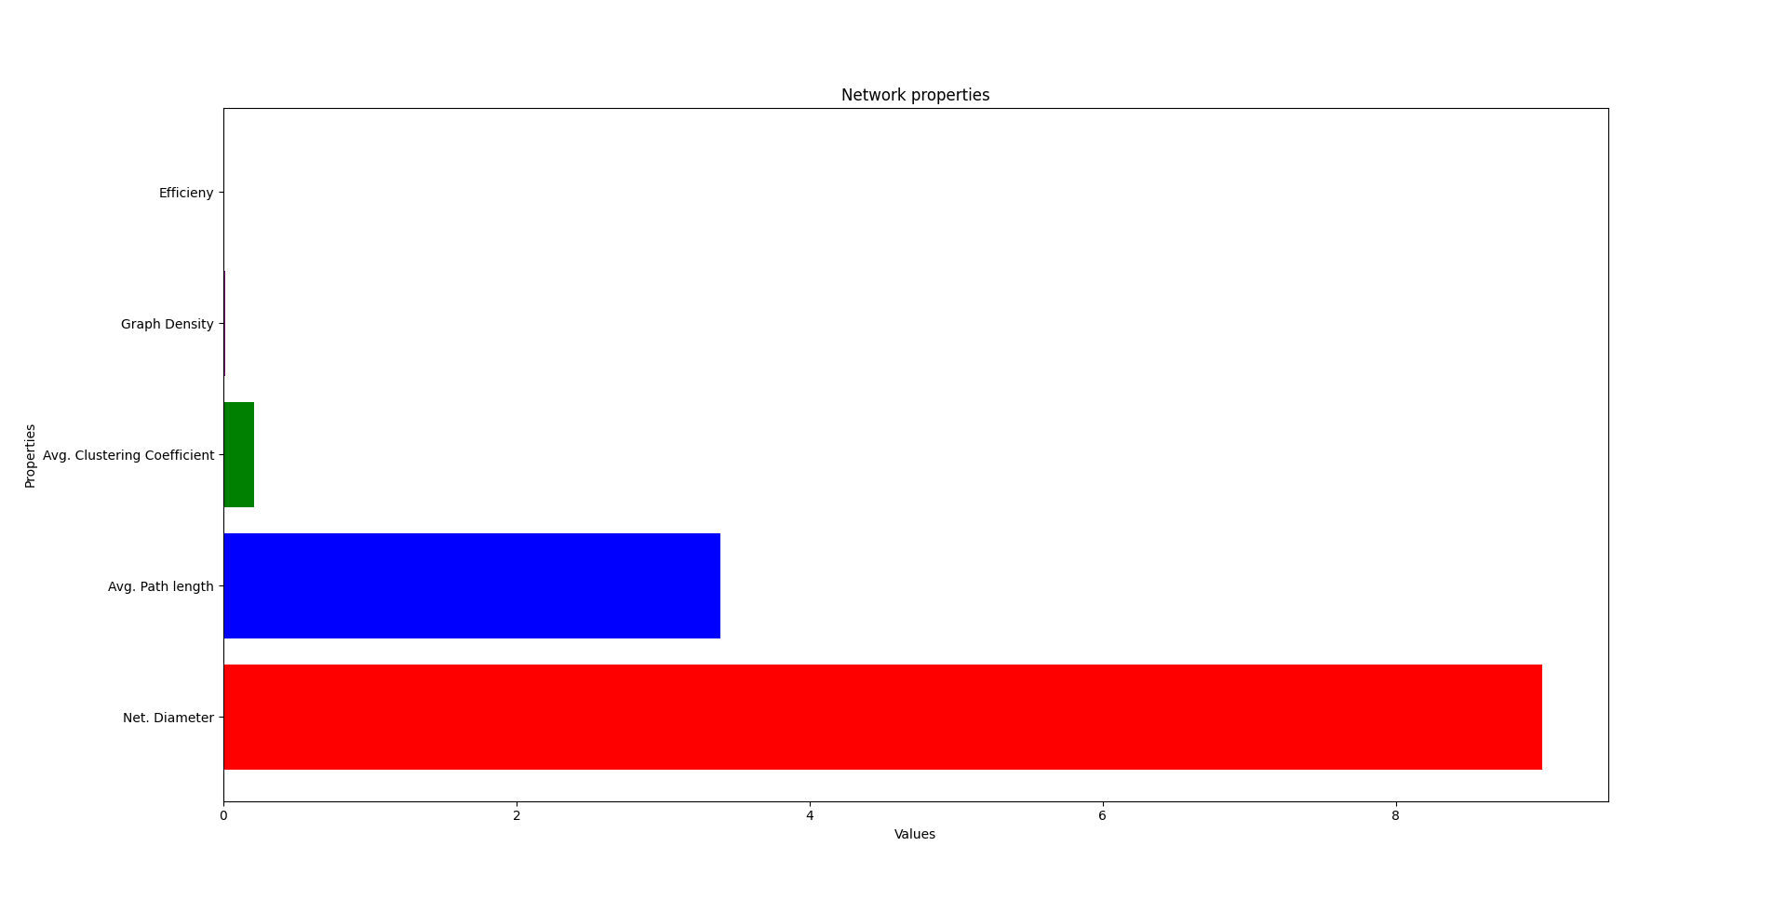
Network properties
A connected network has several properties:
The network diameter is equal to 9
The Average Path length is equal to 3,390
The Average Clustering coefficient is equal to 0,210
The Graph Density is equal to 0,013
The network efficieny is equal to 0,0018

Slide 7
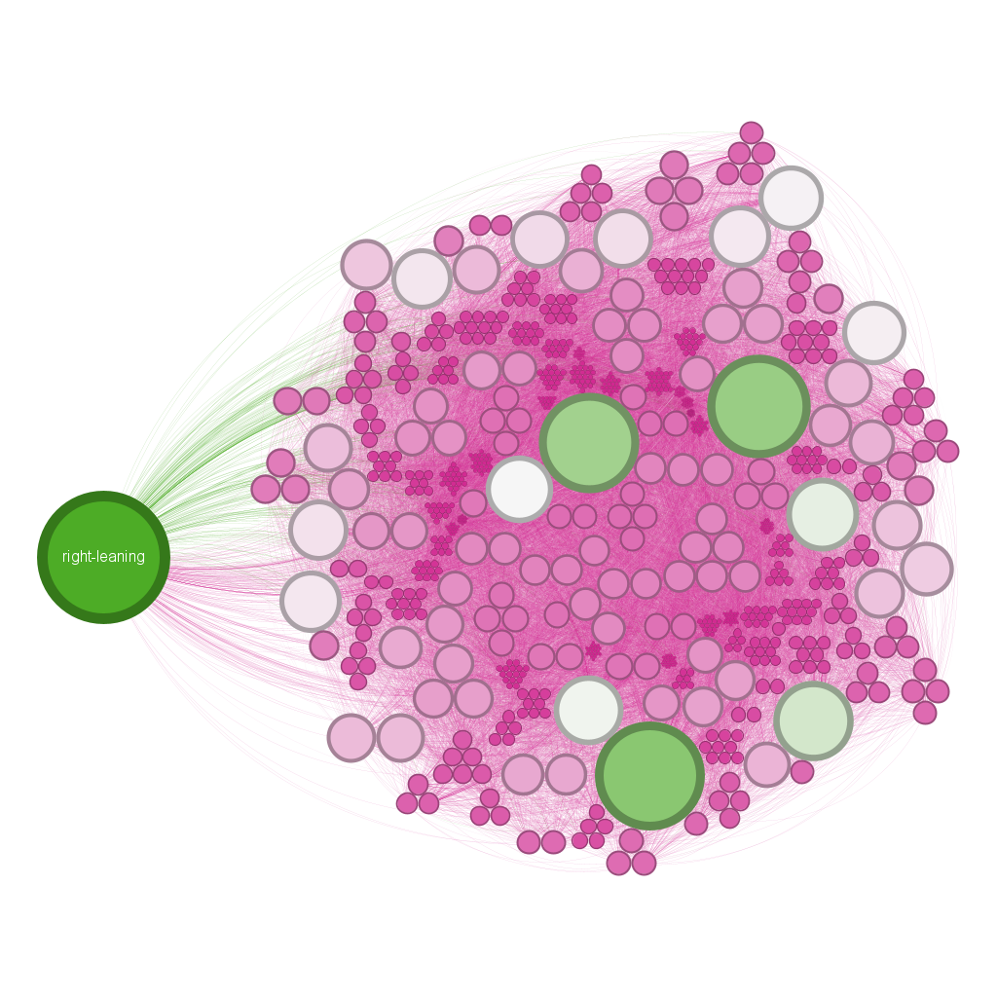
Network properties
The green node is the one with the highest average degree, 467
The average degree is equal to 15,543

Slide 8
Network properties
Conservative blogs show greater tendency to link
82% of conservative blogs linked to at least once; 84% link to at least one other blog
67% of liberal blogs are linked to at least once; 74% link to at least one other blog
Average # of links per blog is similar: 13.6 for liberal; 15.1 for conservative
52% conservative blogs, 48% liberal blogs

Slide 9
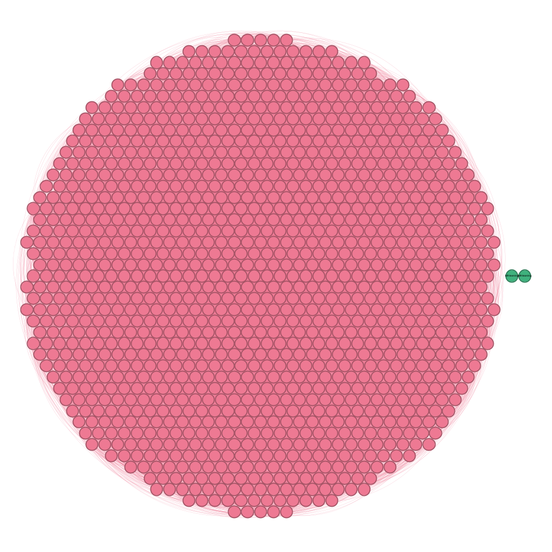
Components
In this case, given that it is a direct network, I calculated the number of the strongly connected components and of the weakly connected components:
SCC = 422
WCC = 2
Pink = SCC
Green = WCC

Slide 10
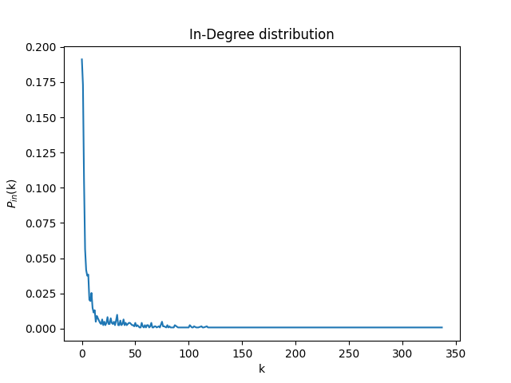
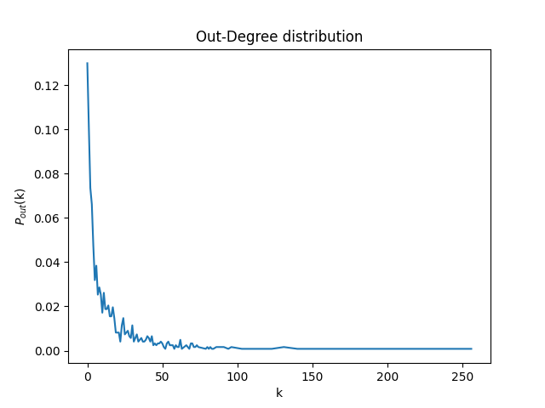
Network properties
I decided to calculate the In- and Out- degree distributions and plot it all
In-degree distribution
Out-degree distribution

Slide 11
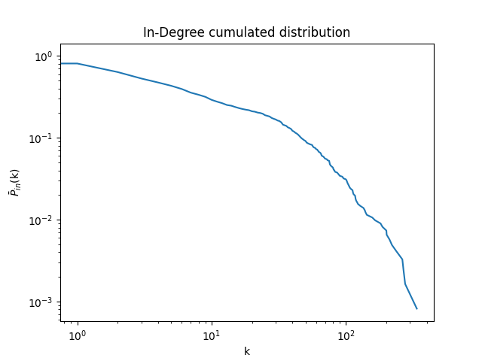
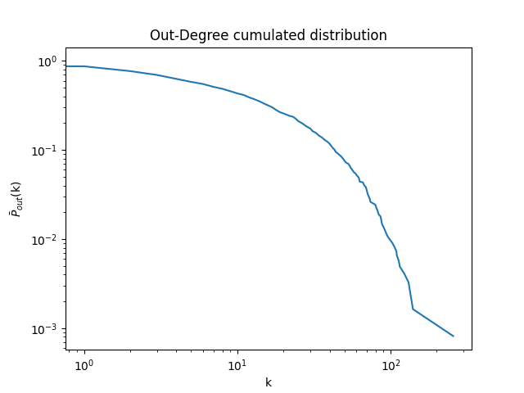
Network properties
Then, i also calculate the In- and Out- degree cumulated distributions and plot it all
In-Degree cumulated distribution
Out-Degree cumulated distribution

Slide 12
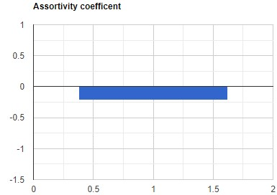
Network properties
To establish if the network is assortative or disassortative, I decided to calculate the assortivity coefficient
The assortivity coefficient is equal to
-0,210
Network is disassortative

Slide 13
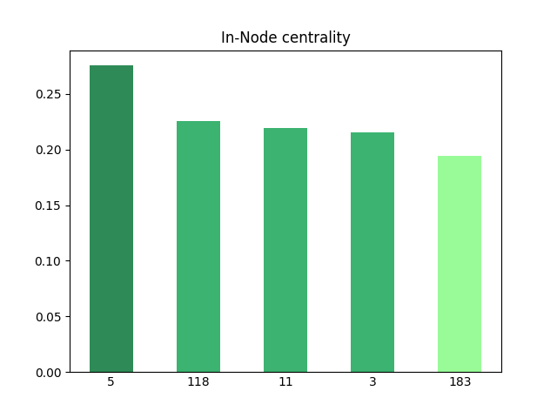
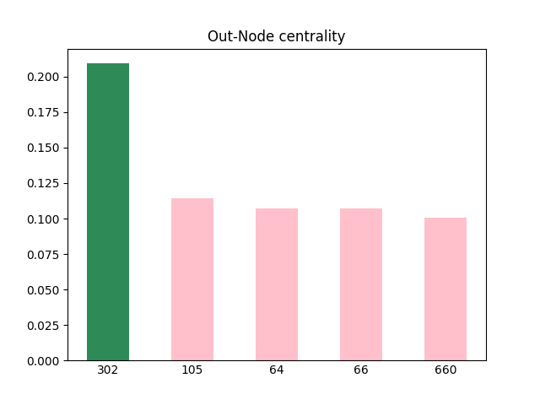
Centralities
Node Centrality

Slide 14
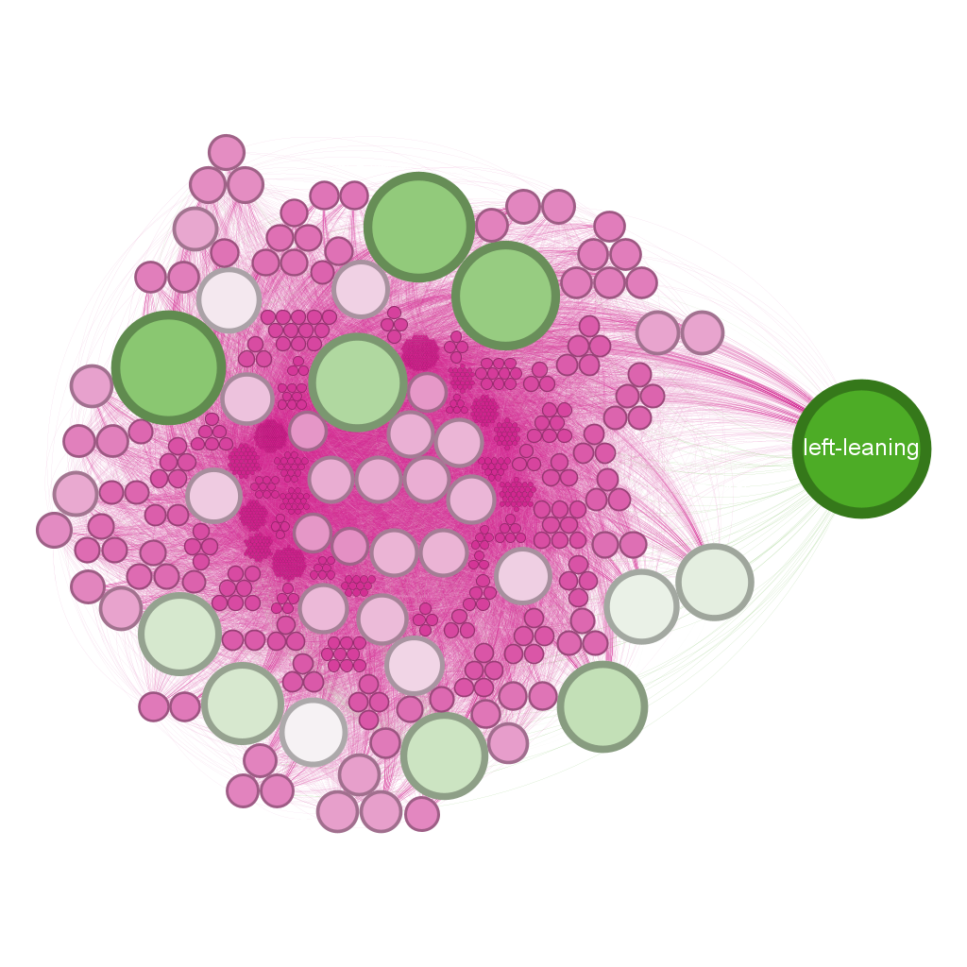
Network properties
The green node is the one with the highest In-Degree
That Degree is equal to 337
Node Id: 5 Orientation: liberal

Slide 15
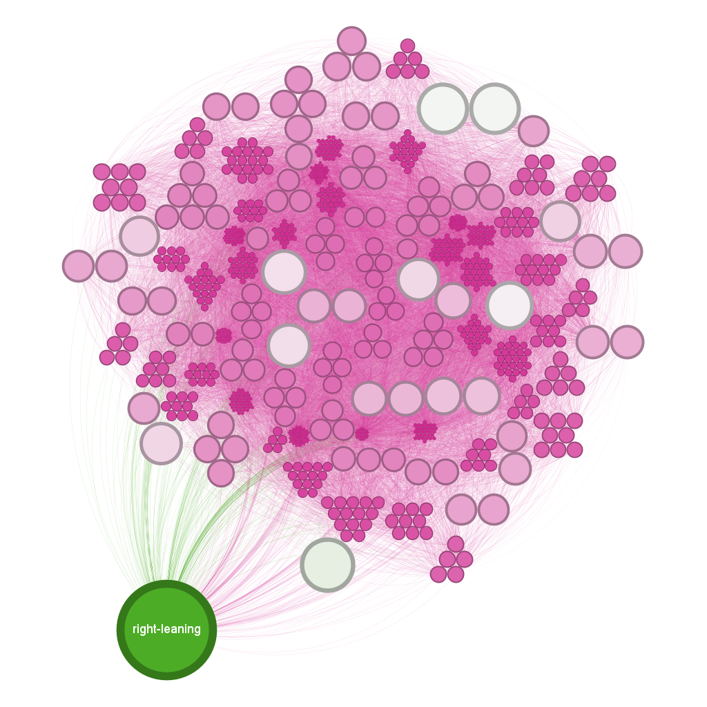
Network properties
The green node is the one with the highest Out-Degree
That Degree is equal to 256
Node Id: 302 Orientation: conservative

Slide 16
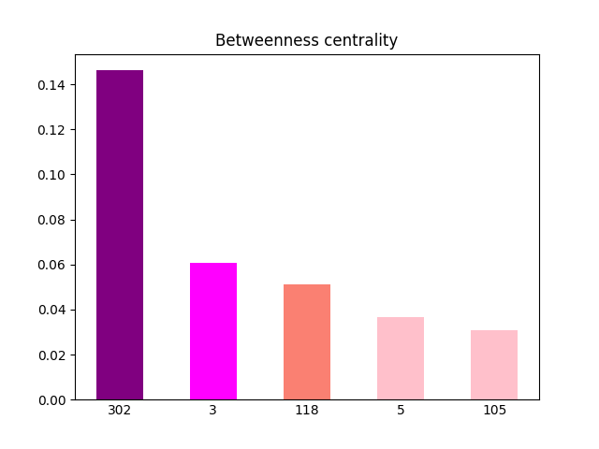
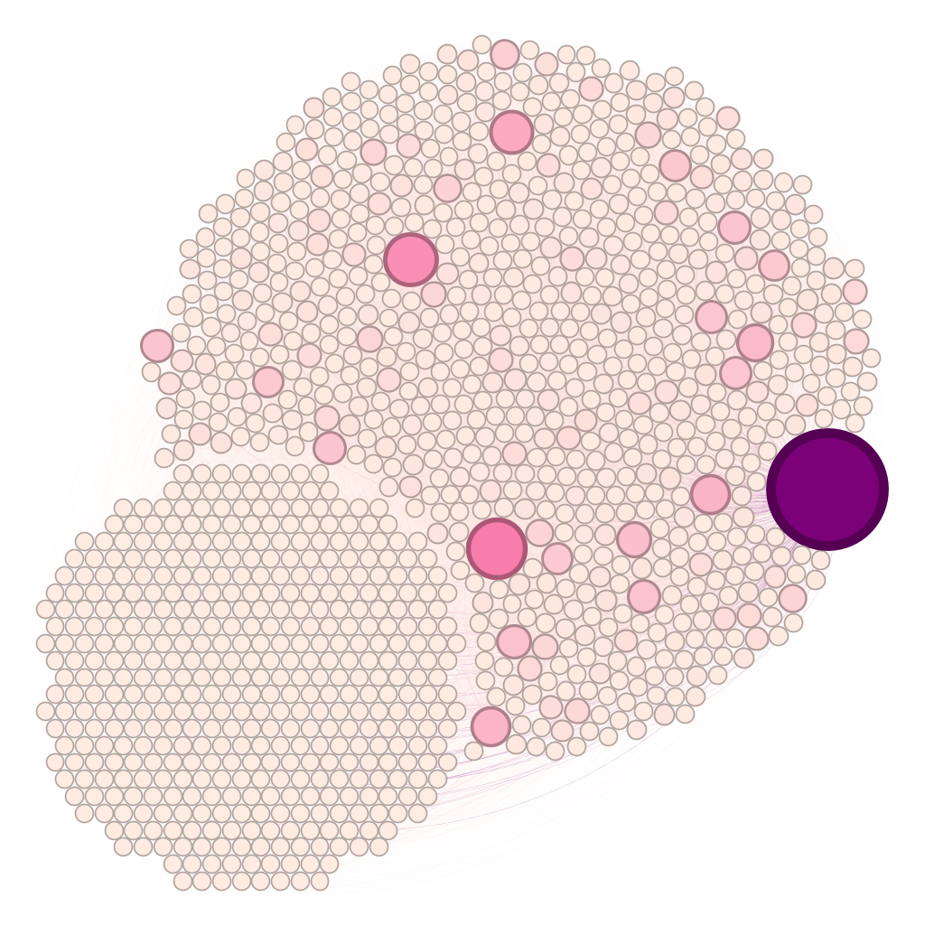
Centralities
Betweenness centrality
Node Id: 302 Orientation: conservative

Slide 17
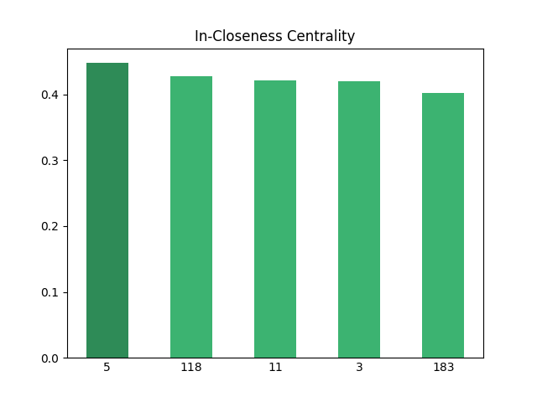
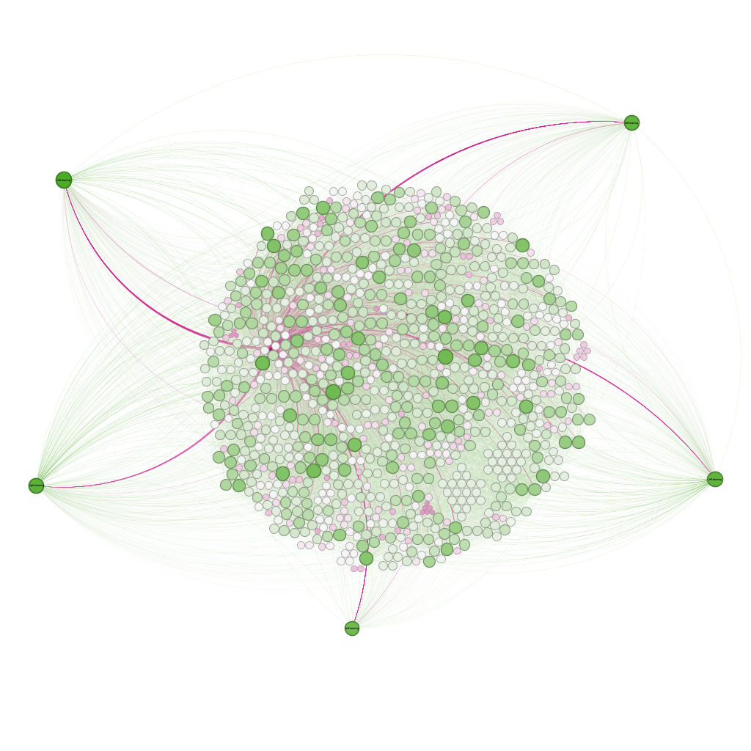
Centralities
Closeness centrality
Whole network was considered
Node: 5 Orientation: liberal

Slide 18
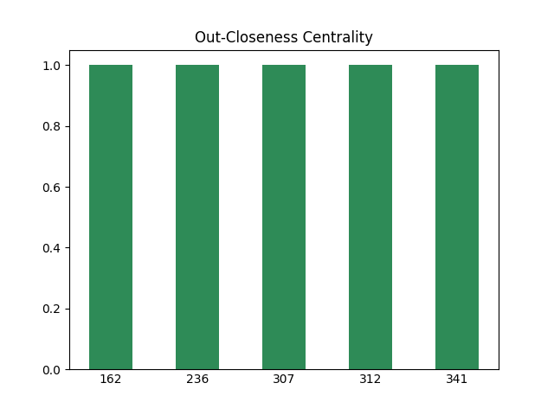
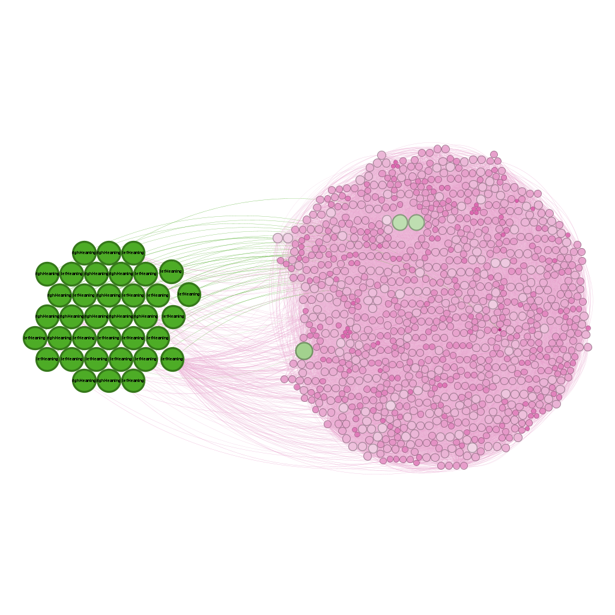
Centralities
Closeness centrality
Whole network was considered
Node: 162 Orientation: conservative

Slide 19
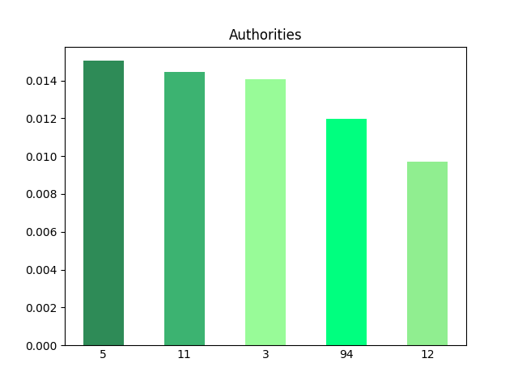
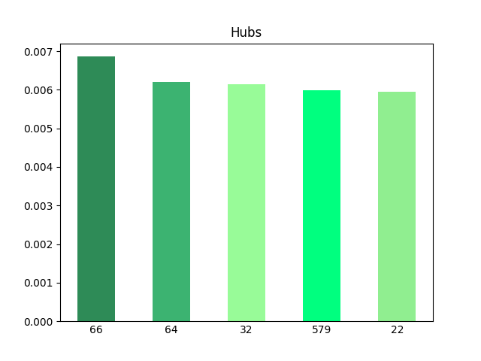
Centralities
Authorities and Hubs

Slide 20
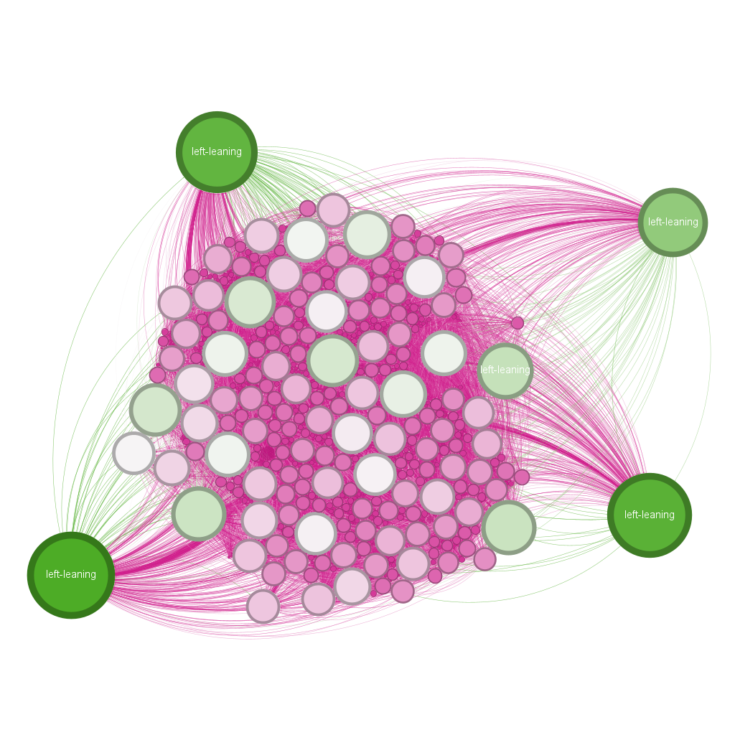
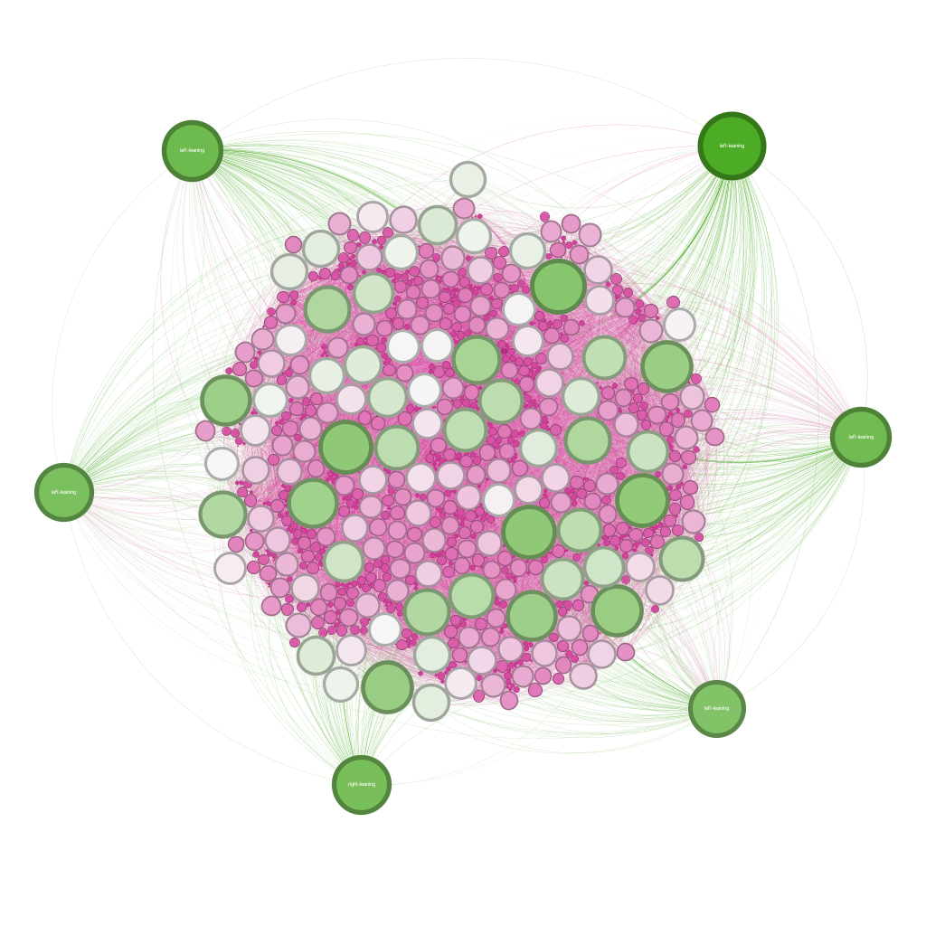
Centralities
Authorities and Hubs
Node Id: 5 Orientation: liberal
Node Id: 66 Orientation: liberal

Slide 21
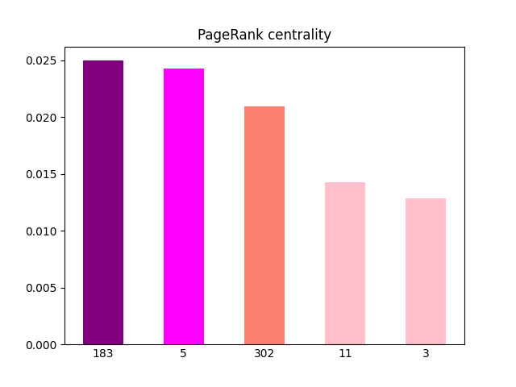
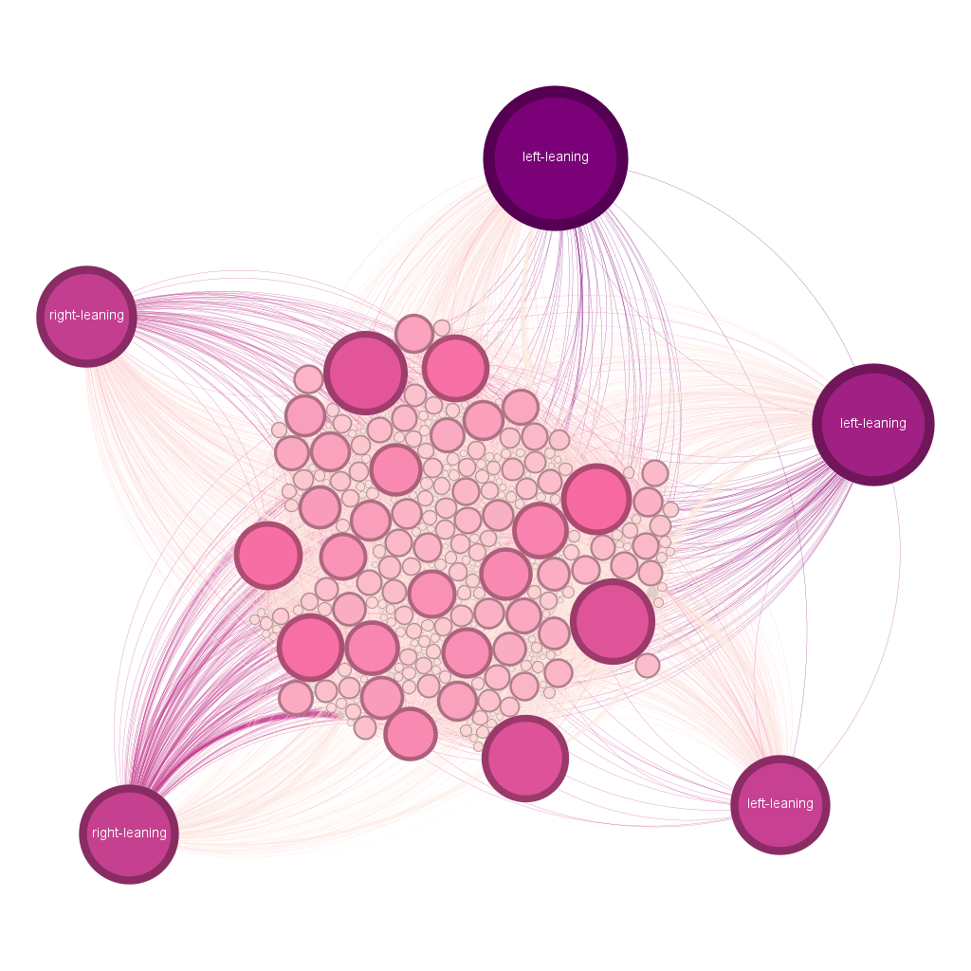
Centralities
PageRank centrality
Node Id: 5 Orientation: liberal

Slide 22
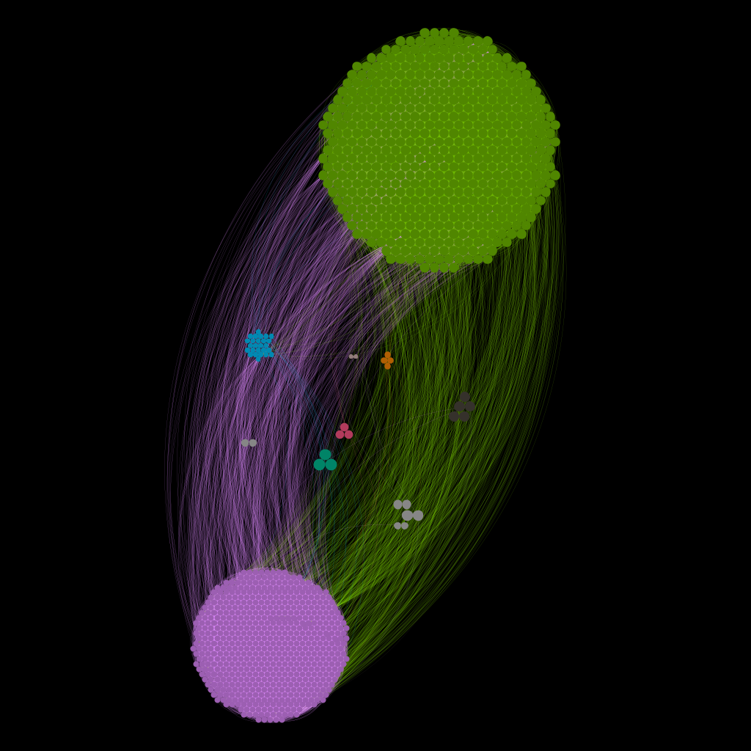
Community analysis
Modularity optimization
The Louvain method was used for this analysis
The network has 12 communities
The modularity is equal to 0.450
The first seven communities have different colors

Slide 23
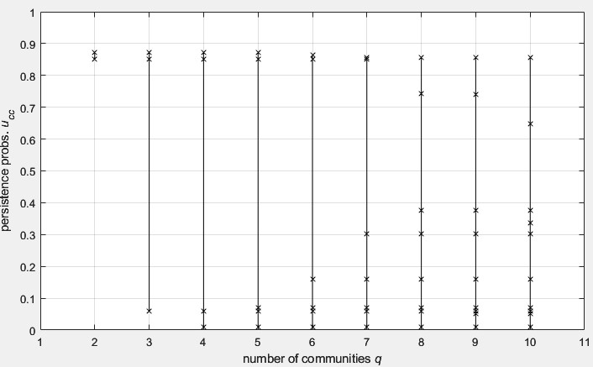
Core-periphery analysis
α-Communities and α-Partitions
Largest strongly connected conmponets was considered
α-Quality level is set to 0,8
1 α-Partitions with 2 q (clusters)
2 communities

Slide 24
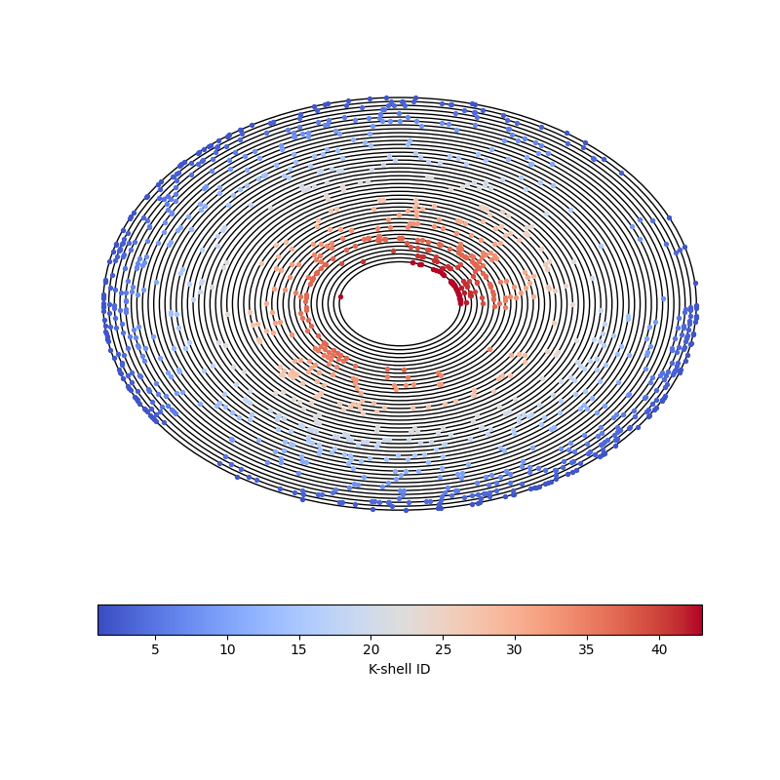
Core-periphery analysis
K-core (k-shell) decomposition
The number of k-shells is equal to 43
The first circle corresponds to the 43th shell
The coldest colors are equal to the first shells while the warmest are equal to the last ones

Slide 25
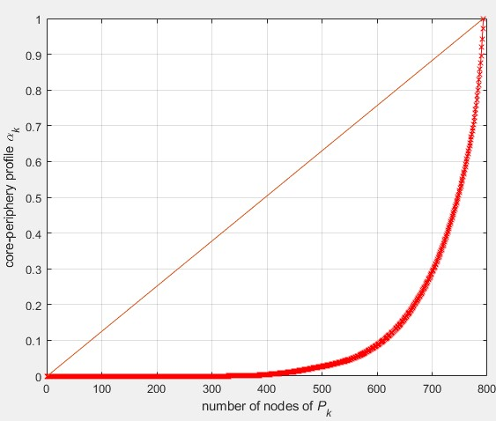
Core-periphery analysis
Core-Periphery profile
Largest strongly connected components was considered
The Core-Periphery score 𝐶 is 0,81644
It seems like a star nets

Slide 26
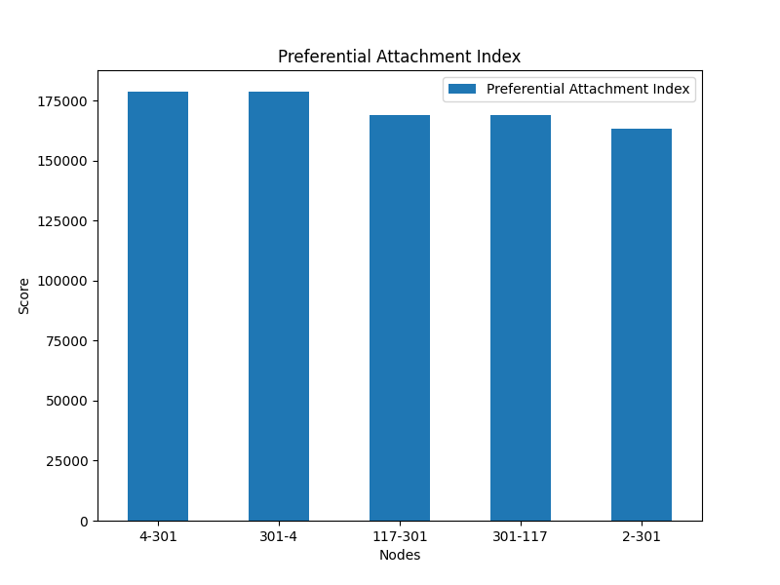
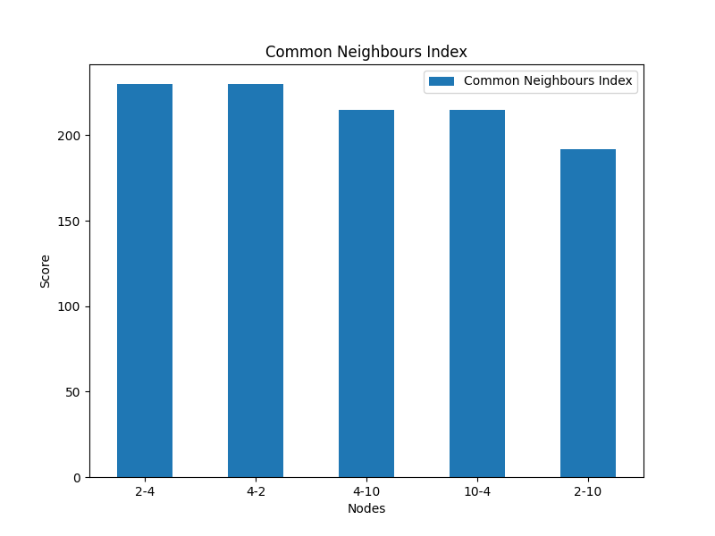
Link prediction
Whole network was considered
4 (liberal) – 301 (conservative)
117 (conservative) – 301 (conservative)
Whole network was considered
2 (liberal) – 4 (liberal)
4 (liberal) – 10 (liberal)

Slide 27
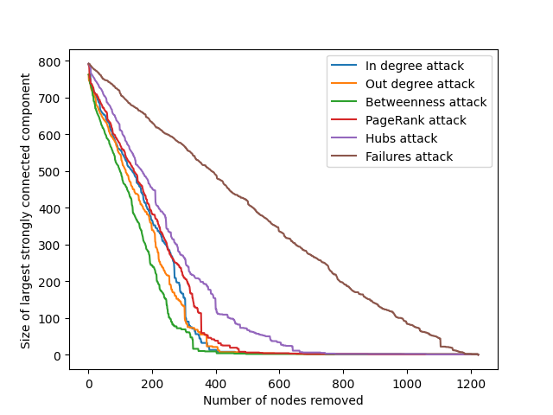
Robustness
Largest connected component was considered
It behaves like a free scale

